Slide 1
TEAM 2
Miguel Balleza | Louie Kafka | Ligia Lobo | Juliet Vickio | Hansini Vyas

Slide 2
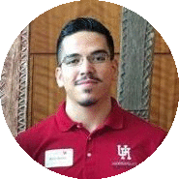

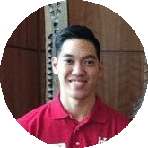

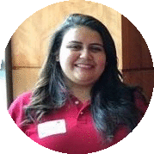
Meet the Team
Miguel Balleza
Bluetooth Integration/Game
Application Login & Testing
Juliet Vickio
Raspberry Pi/Sensors
Connection & Testing
Louie Kafka
Game Development
Connection & Testing
Hansini Vyas
User Interface
Connection & Testing
Ligia Lobo
Database
Sensors Construction & Testing

Slide 3
PROBLEM
Sprained ankles are not a big deal…
People who believe this and ignore their injury may have problems down the road.¹
People who know this isn’t exactly true but can’t afford to spend time and money choose to take their chances.
(1) “Ignoring a sprained ankle can become a bigger pain later in life.”

Slide 4

EXISTING SOLUTION vs OUR SOLUTION
Orca Health
PT Pal Pro
BlueJay PT
Optimal Wellness
Provides Videos for patients
Provides Reminders for patients
Connects to Physical Therapist.
Updates Exercises and training for patient
Sends Progress to Physical Therapist
Provides Videos for patients
Provides an interactive exercise
Provides Update Status for patients
Connects to Physical Therapist

Slide 5
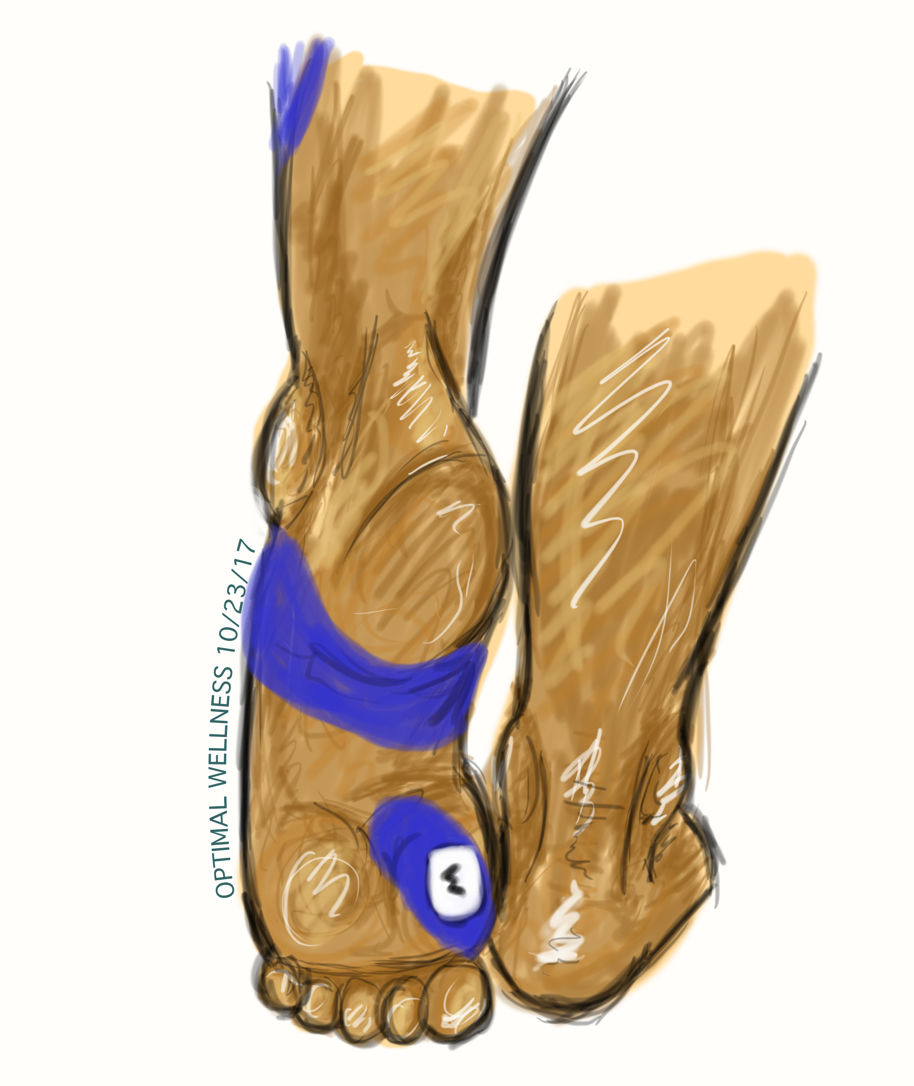
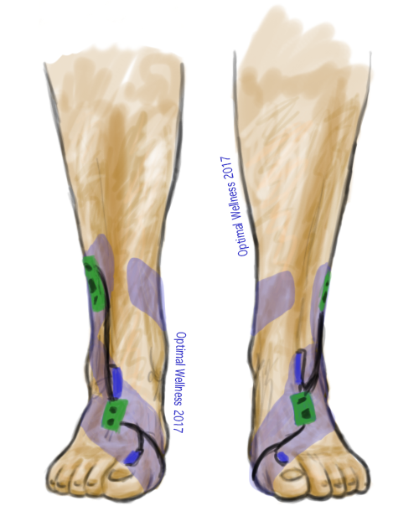
PRODUCT CONCEPT
Reusable
Detachable Components
Light and Small
Adjustable
Notes:
Do you want to add this slide before you talk about the application and how
that works so the audience has an idea of the what the product looks like while they’re learning about the application?

Slide 6
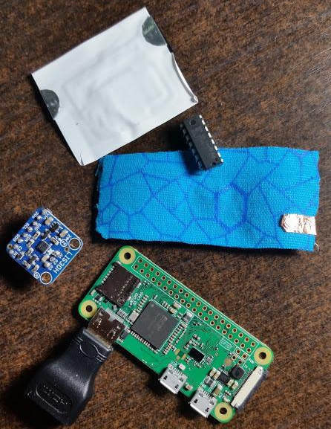
HARDWARE/SENSORS
Custom Sensors
Flex Resistor Sensors
Sends strain data
Adafruit LIS3DH
Gyroscope
Recognizes the Flex and Point
MCP3008 ADC
Reads up to 8 analog sensors
Raspberry Pi Zero W
Microcontroller
Bluetooth Embedded

Slide 7
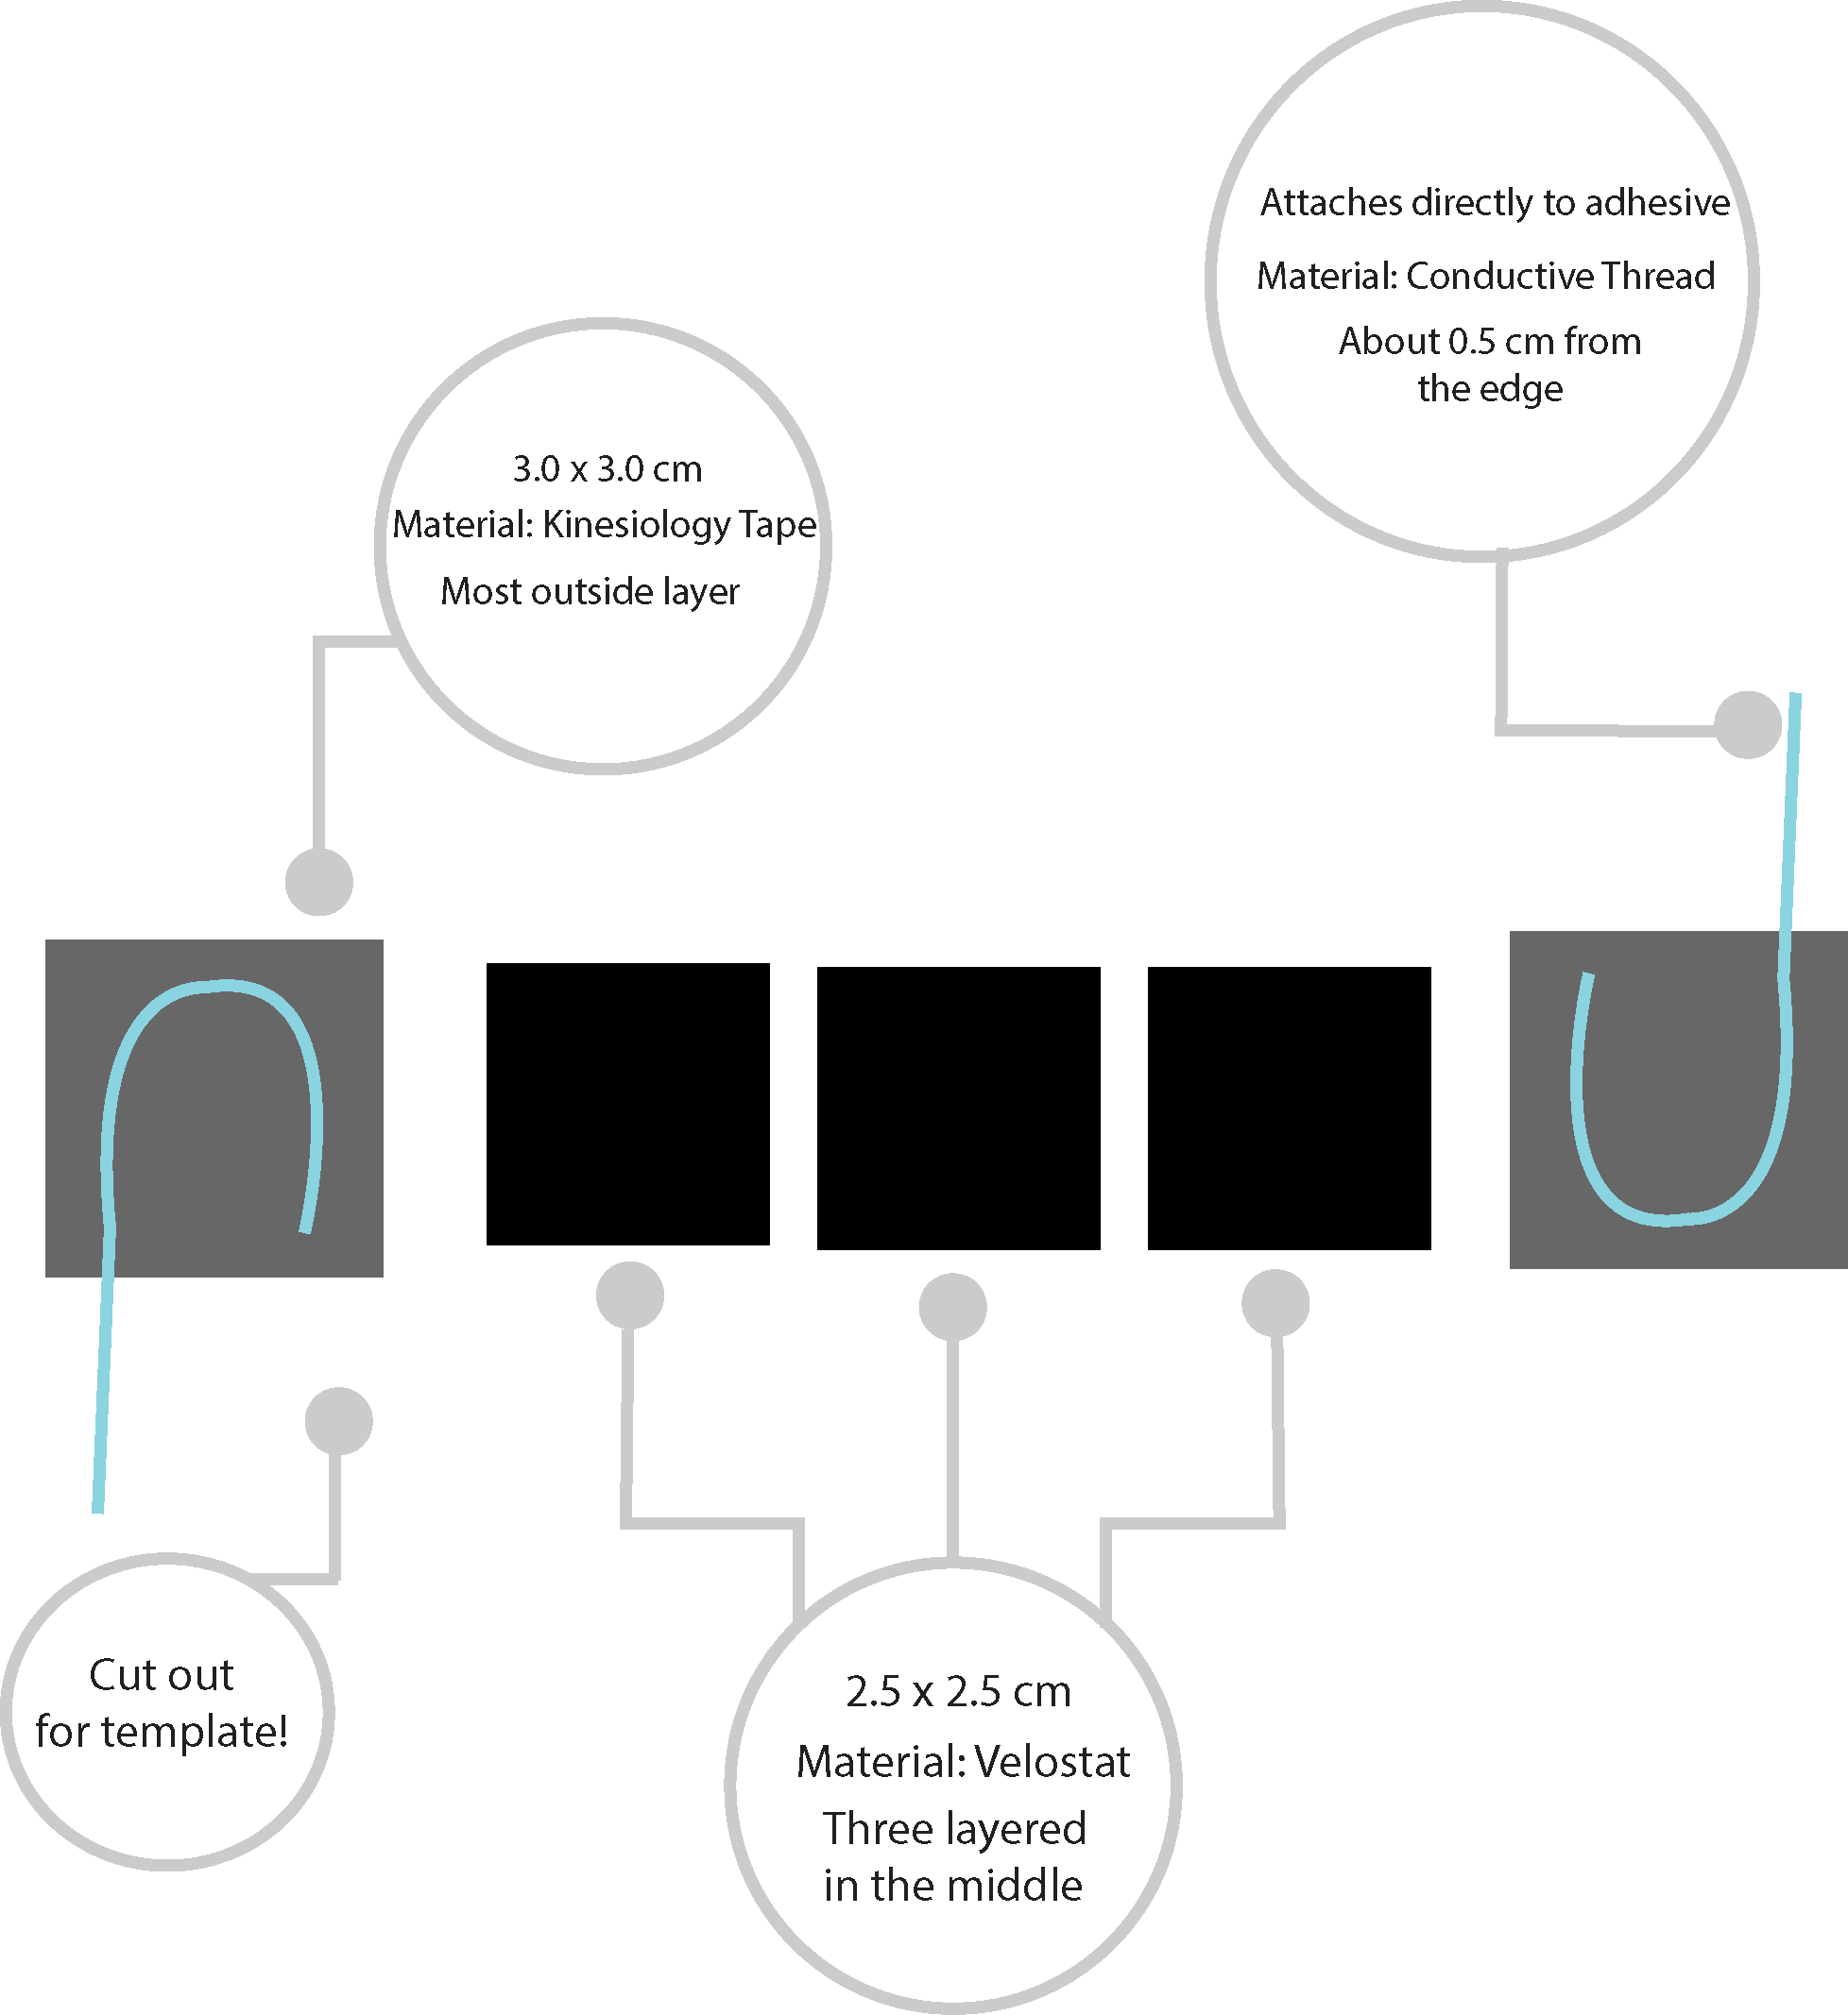
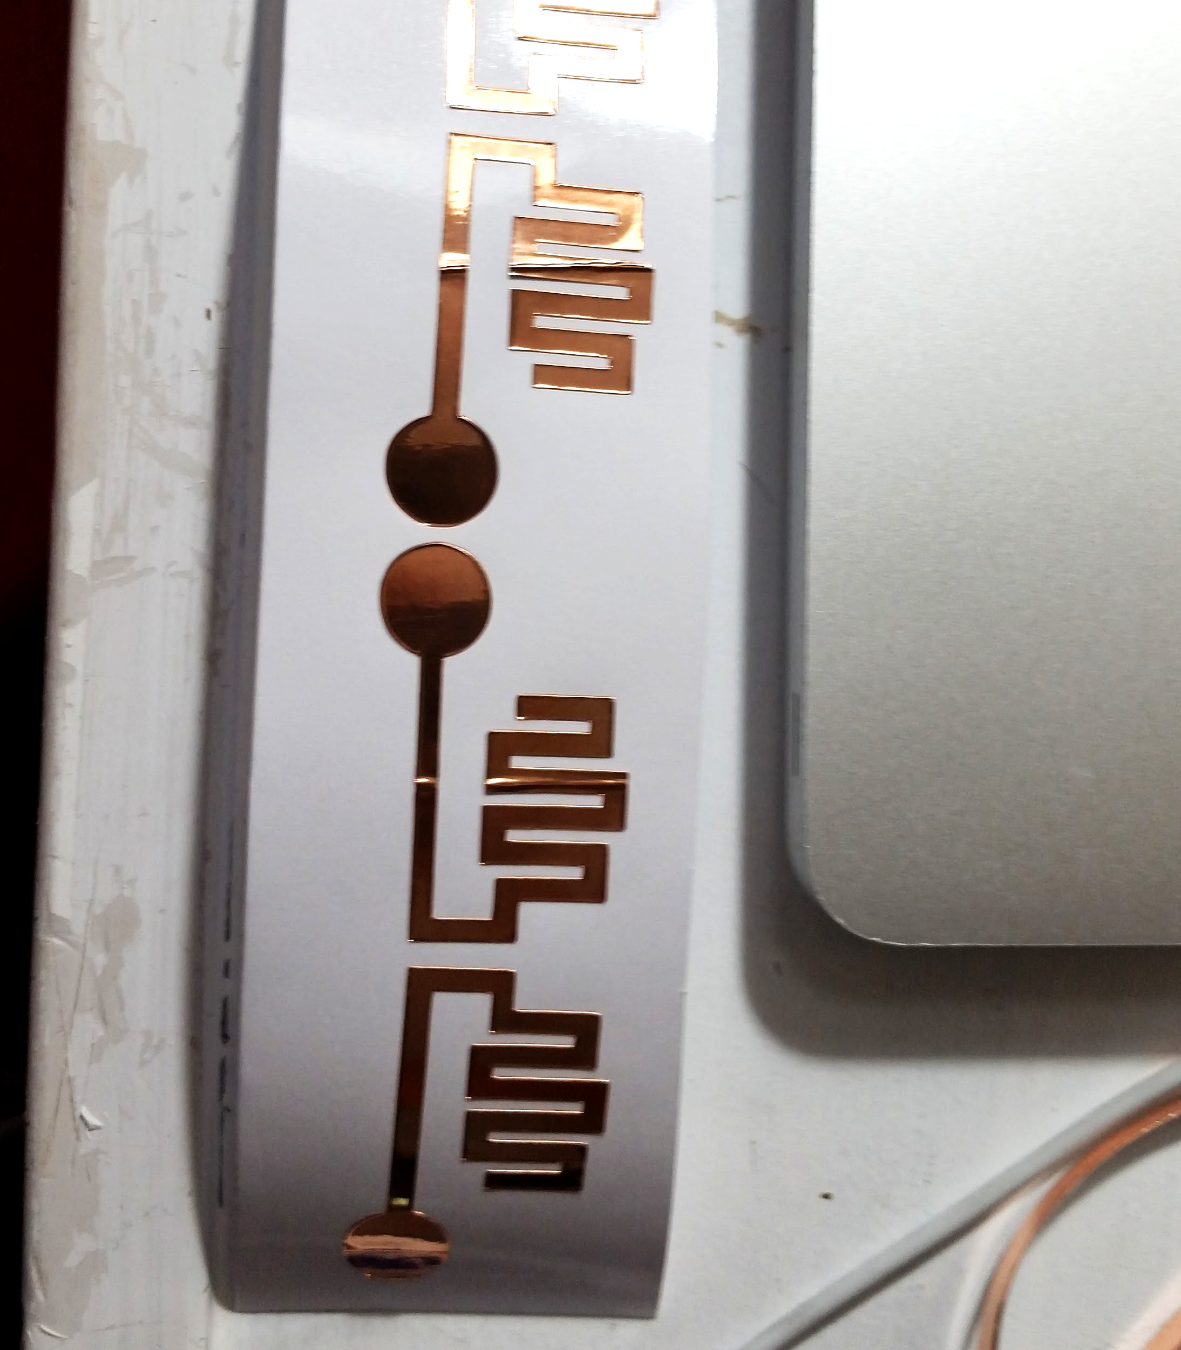
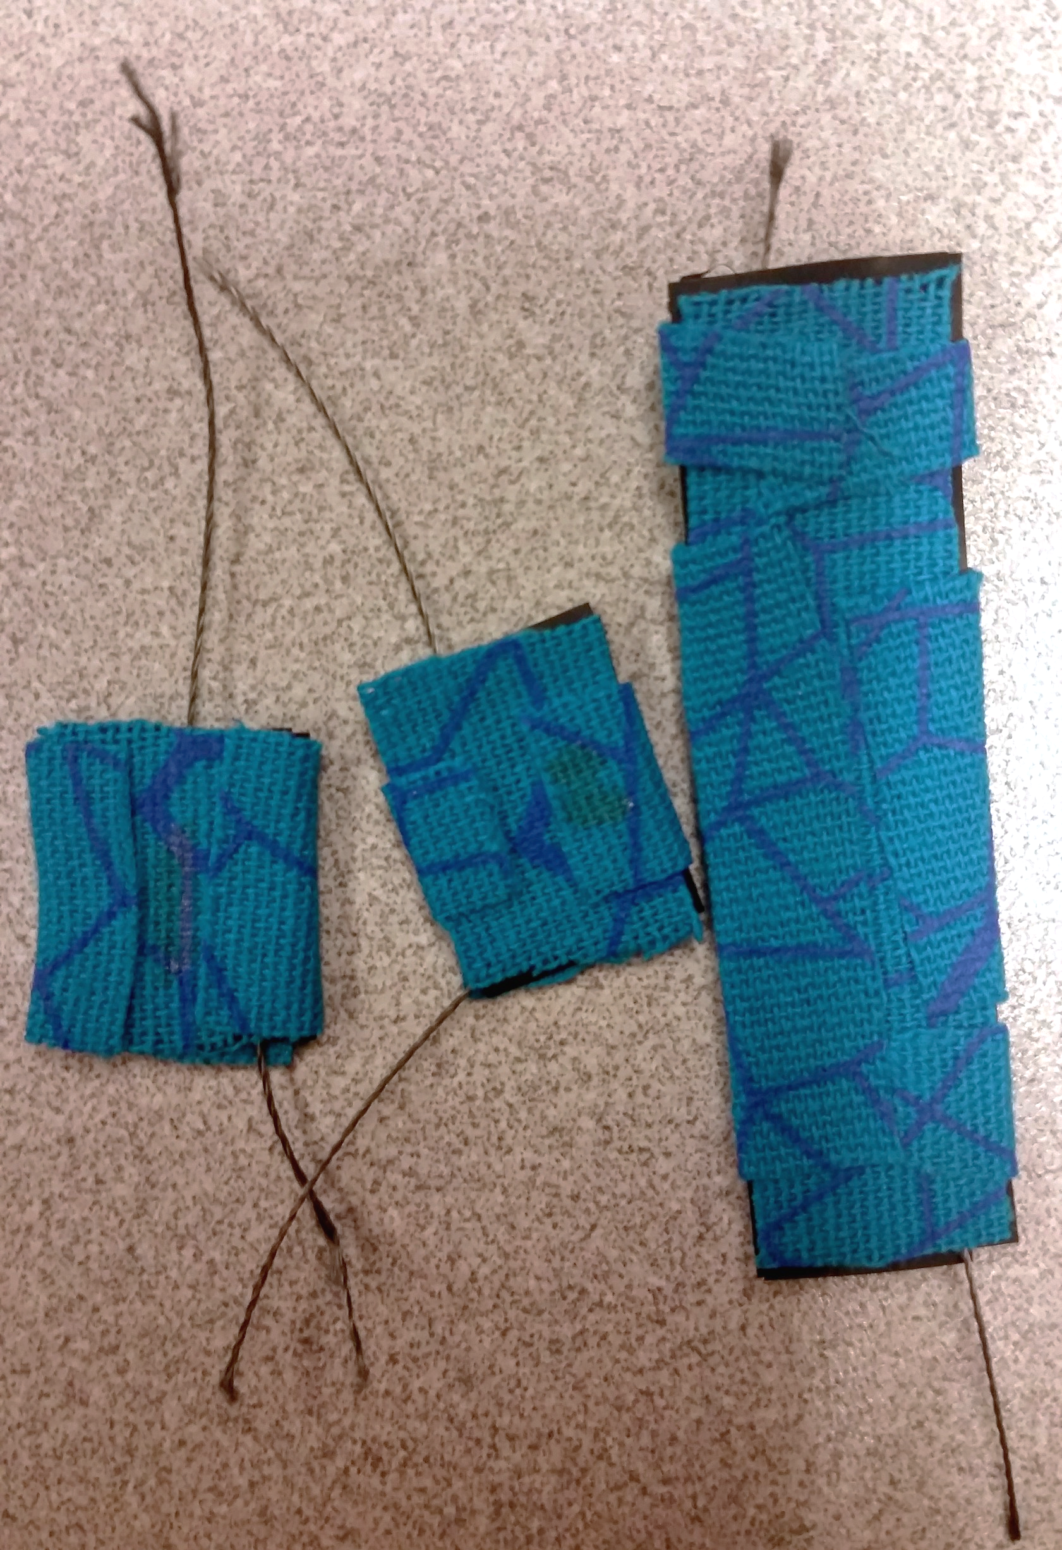
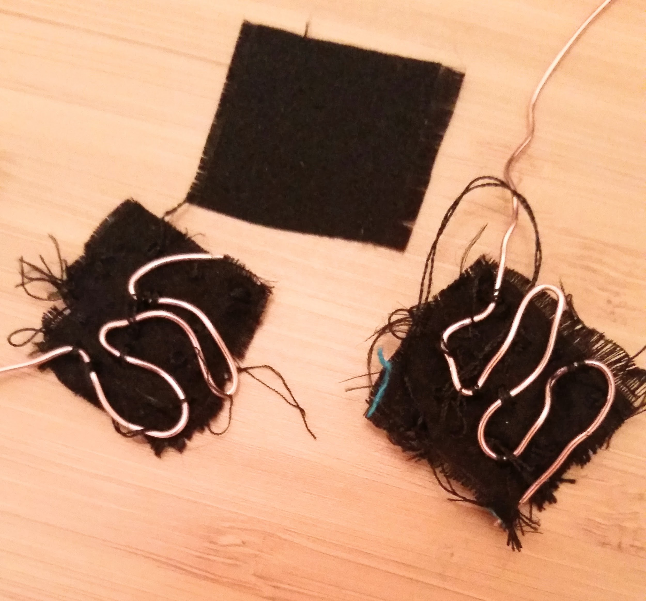
HANDMADE SENSORS CONSTRUCTION
Custom Sensors

Slide 8
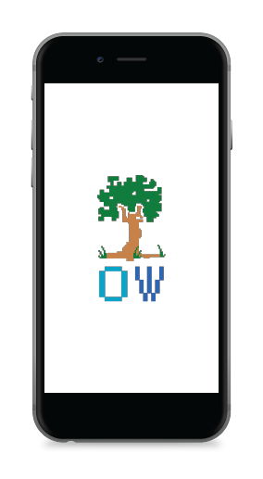
APPLICATION
05
Gameplay
Login Screen
01
04
Range-of-Motion
Home Page
02
03
Device Sync

Slide 9
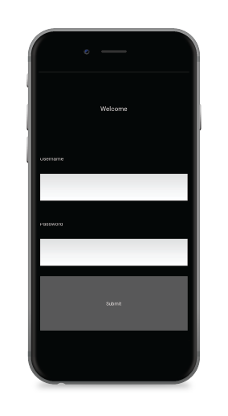
APPLICATION
Login Screen
User will be prompted to login whereas new users are able to register their accounts through our secured database.
05
01
04
02
03

Slide 10
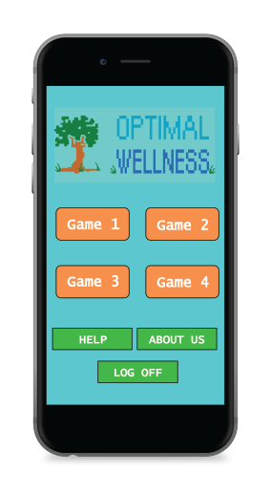
APPLICATION
05
01
04
Home Page
Once logged in, the user will be directed to the home page which will provide assistance in setting up before
beginning gameplay.
02
03

Slide 11
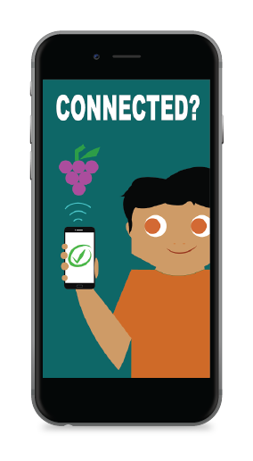
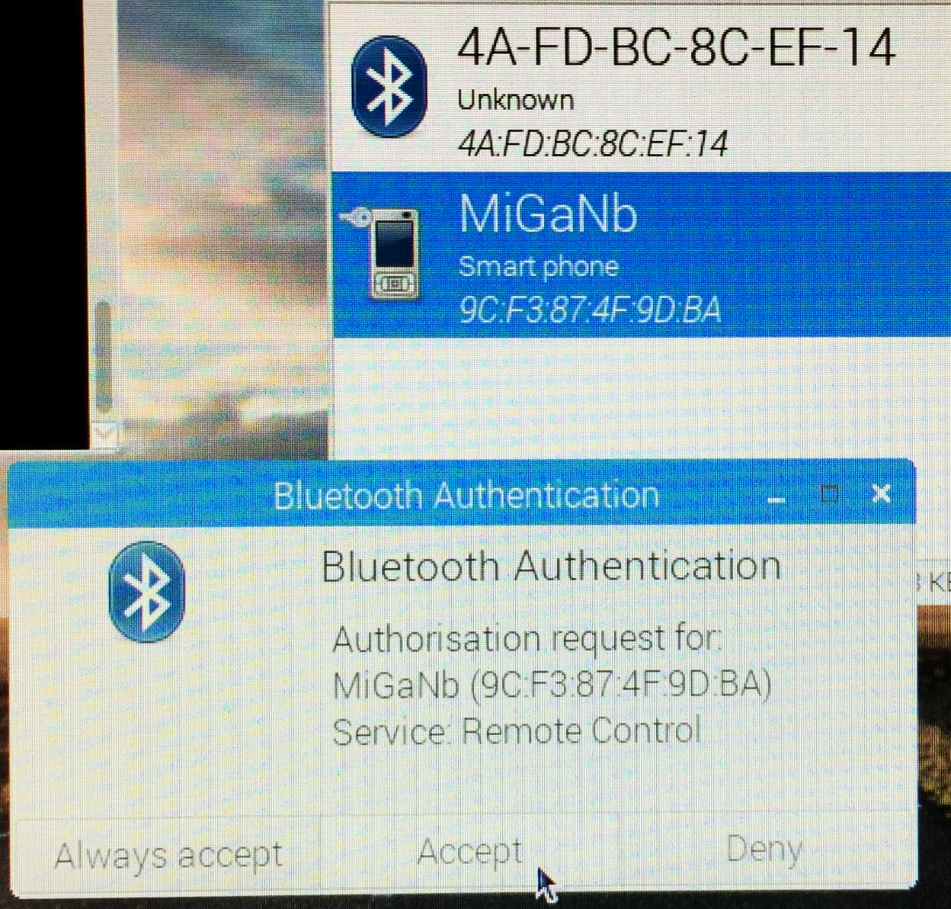
APPLICATION
05
01
04
Device Sync
The user will first be prompted to sync their OW device to their mobile device.
02
03

Slide 12
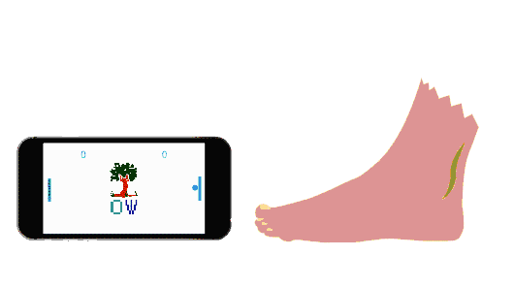
APPLICATION
05
Range-of-Motion
Once connectivity has been established, the final step is for the user to set their range-of-motion.
01
04
02
03

Slide 13
APPLICATION
05
Gameplay
The user will then choose a game of their preference. After selecting a game, the OW device will be enabled as a controller for the user to use for the gameplay.
01
04
02
03

Slide 14
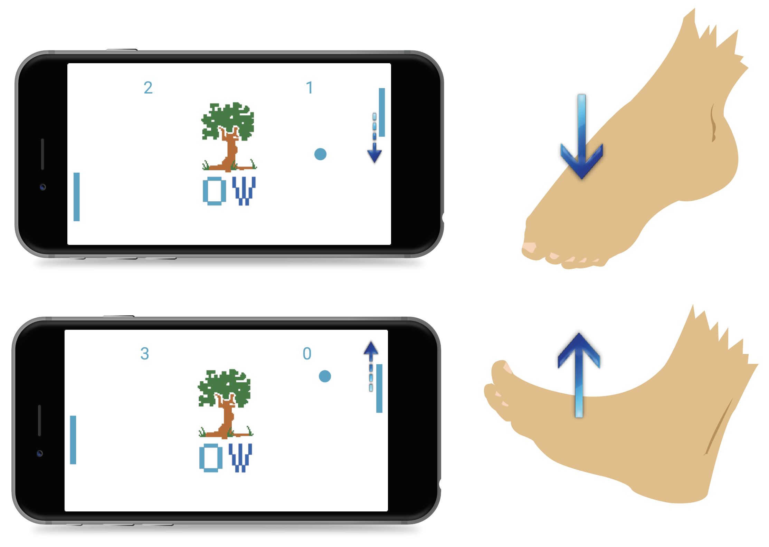
PING PONG
Utilizes Kivy, a Python based library
Before the start of gameplay the user will set their range of motion by following the directives from the app
The user may then use their foot to control one paddle in Pong (right paddle) to compete against their automated digital rival (left paddle)
The idea is for the user to flex and extend their feet in order to stretch out their ankle

Slide 15


GOLDEN CIRCLE
Why?
We want to empower the (lazy) active individual.

Slide 16

GOLDEN CIRCLE
Why?
We want to empower the (lazy) active individual.
How?
By creating affordable and immersive therapeutic technology.

Slide 17

GOLDEN CIRCLE
Why?
We want to empower the (lazy) active individual.
How?
By creating affordable and immersive therapeutic technology.
What?
Making a skin adhesive wearable technology designed to integrate with a customized phone app.

Slide 18
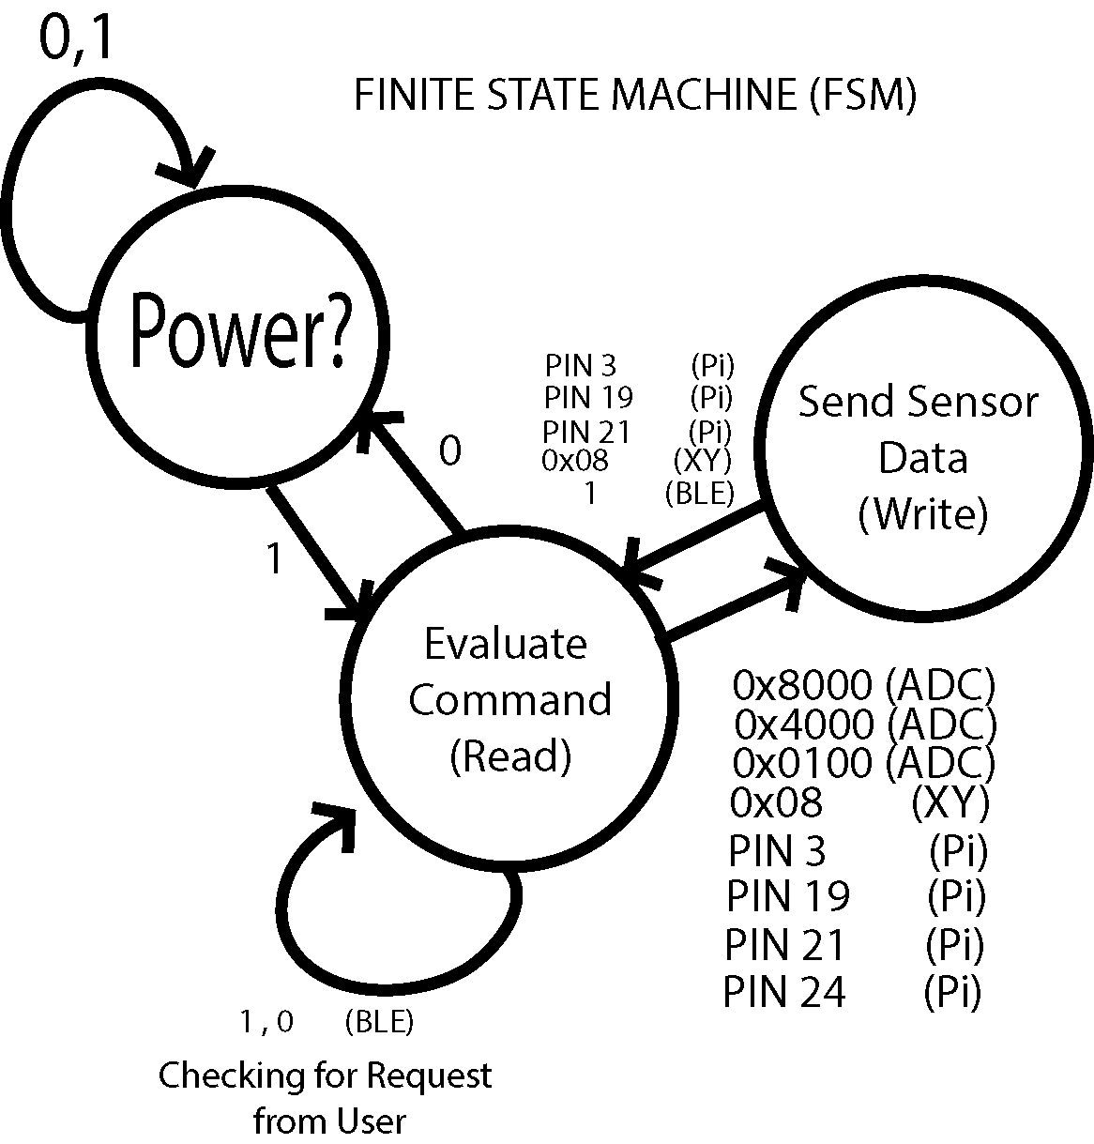
FINITE STATE MACHINE (FSM)
Power On
Read Data
Write Data

Slide 19
GLOBAL & SOCIETAL IMPACT
Users
Mutual
Therapists
Accessible
Affordable
Easy to use
Higher chances of therapy completion
Alternate solution
Interactive
Faster results
Increased number of customers
Increased profit

Slide 20

Cost Analysis
Individual Cost Per Unit
# | Item from Bulk | Amt | Cost
1 | Raspberry Pi Zero W | 1.00 | $3.34
2 | MCP3008 Chip | 1.00 | $1.74
3 | MicroSD Card (8GB) | 1.00 | $0.79
4 | Adafruit LIS3DH Chip | 1.00 | $4.95
5 | Kinesiology Tape Roll | 1.00 | $1.39
6 | Conductive Thread Bobbin | 0.07 | $0.10
7 | Velostat | 0.01 | $0.01
8 | 14 Gauge Single Wire Roll | 0.10 | $0.07
9 | 20k Ohm Resistor | 3.00 | $0.00
10 | Headers | 1.00 | $0.41
11 | PCB Boards | 1.00 | $0.33
12 | Vinyl | 1.00 | $0.30
13 | Unforeseen Cost | 1.00 | $2.57
TOTAL |  |  | $16.00

Slide 21

POTENTIAL MARKET
Target Audience
Physically active adults or professional athletes.
Partners
Physical Therapists and Pharmacies.
Activities
Accessibility and Consistent Support.
Resources
Secure SQLite Database and a Proper Connection
Value
providing an interactive platform to receive physical therapy.

Slide 22
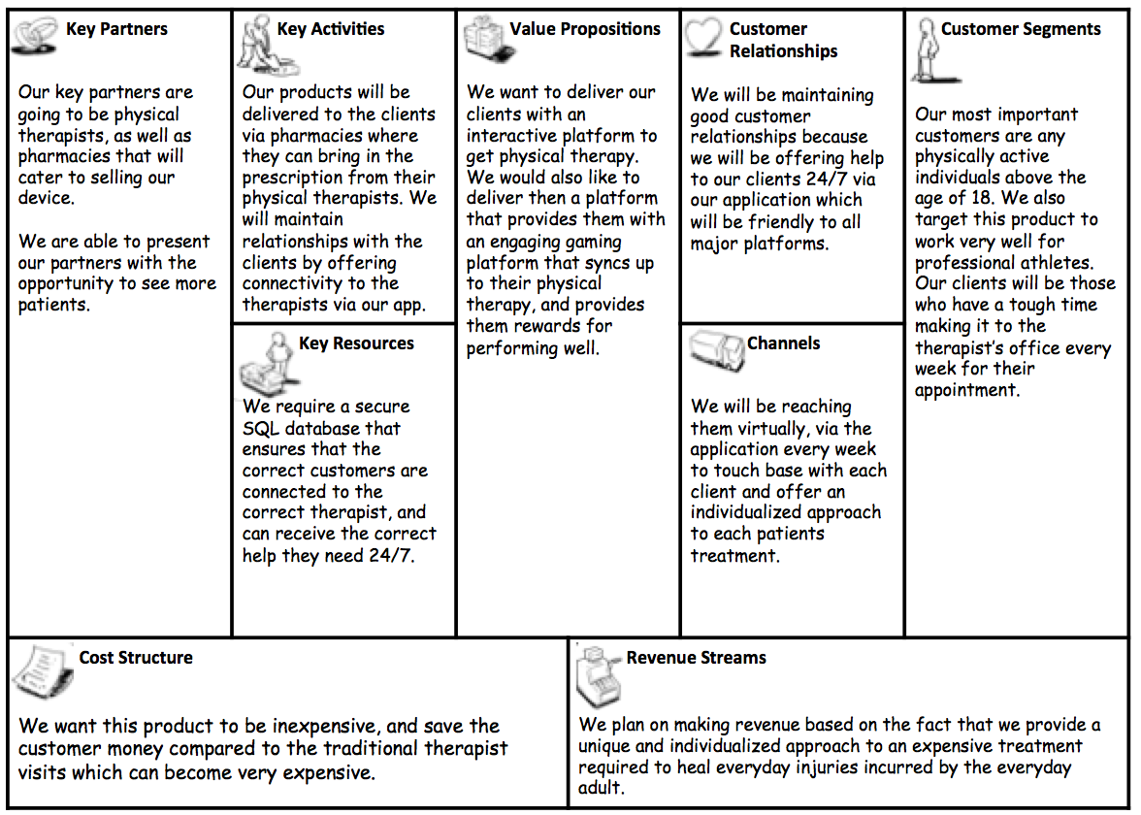
Business Plan

Slide 23

FUTURE IMPROVEMENTS
Notes:
Smaller
Offer rewards
Easier communication with therapist
More games
Target more exercises

Slide 24
TIMELINE/STATUS
Begin constructing Sensors/Testing Materials
Begin designing Use Interface
Continue Sensor Construction
Continue Developing User Interface
Finish
Connecting
Sensors
And Application
Work on Final Report
SEPT
OCT
NOV
DEC
Design Kivy Application
Continue developing SQLite Database
Work on
Wireless Connectivity
Work on Final Presentation
Symposium
Begin writing Program on Kivy
Begin working on Secure SQLite Database

Slide 25
Gantt Chart

Slide 26
DEMO/VIDEO
Still in the works :)

Slide 27

REFERENCES
“Ignoring a sprained ankle can become a bigger pain later in life.” Hospital for Special
Surgery, Hospital for Special Surgery (HSS), 23 May 2008,
www.hss.edu/newsroom_sprained-ankle-ignored.asp.
“Salerio presentation template.” Slides Carnival, Slides Carnival, 2017,
www.slidescarnival.com/salerio-free-presentation-template/1875.
“7 Highest Paying Countries for Physical Therapists.” Insider Monkey, www.insidermonkey.com/blog/7-highest-paying-countries-for-physical-therapists-594093/8/.
“Which Countries Pay the Best Physiotherapy Salary?” Which Countries Pay the Best Physiotherapy Salary? ~, Everything Physio, www.everythingphysio.com/2016/04/physiotherapy-career-which-countries.html.
Reference Guide Clipart | Clipart Panda - Free Clipart Images, www.clipartpanda.com/clipart_images/reference-guide-clipart-65056310.

Slide 28
REFERENCES

Slide 29
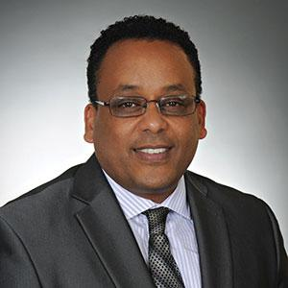
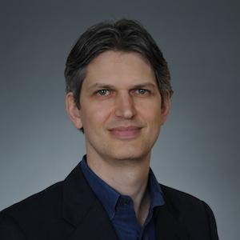
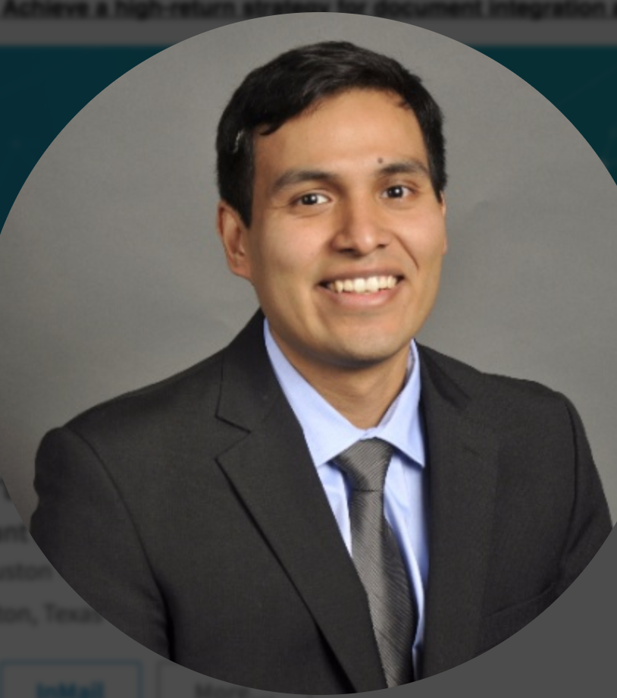
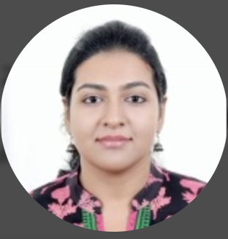


ACKNOWLEDGEMENTS
Dr. Pollonini
Dr. Moges
Alberto Rosas
Mayuri Harikumar
Aaditya Iyer
&

Slide 30

QUESTIONS

